Slide 1
Learning Objective
I will be able to define the geometric infinite series
Success Criteria
At the end of the lesson, I will be able to:
define the concept of an infinite sum and review ideas of convergence and divergence;
determine geometric sums using a recursive process;
derive the infinite geometric sum (series) formula and use it to calculate the infinite sum;
find the common ratio or first term, given sufficient information;
apply infinite geometric sums to applied problems involving exponential growth and decay.

Slide 2

Geometric Series
Concept Development
The sum of a geometric sequence is called a geometric series.
For a general geometric series with the first term, $a$, and common ratio, $r$:
$$S_{n}=\frac{a(1−r^{n})}{1−r} r≠1$$
If $r>1$ or $r<−1$, i.e. $|r|>1$, then the formula can be rearranged in the following form:
$$S_{n}=\frac{a(r^{n}−1)}{r−1} r≠1$$

Slide 3
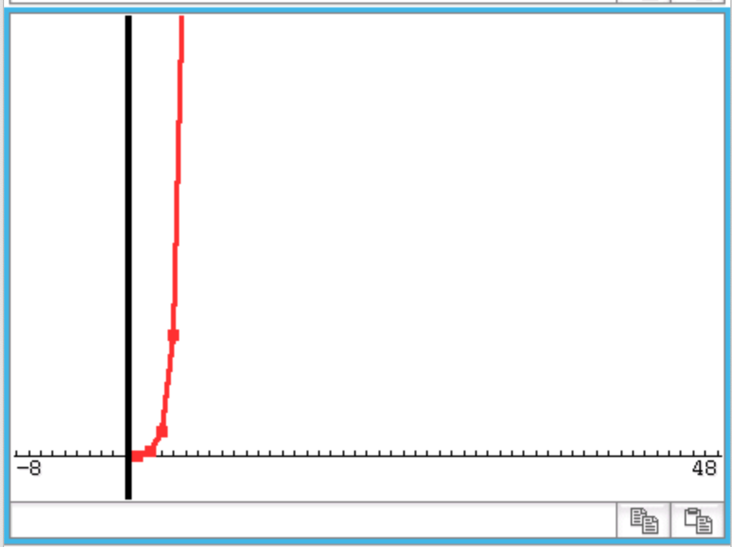
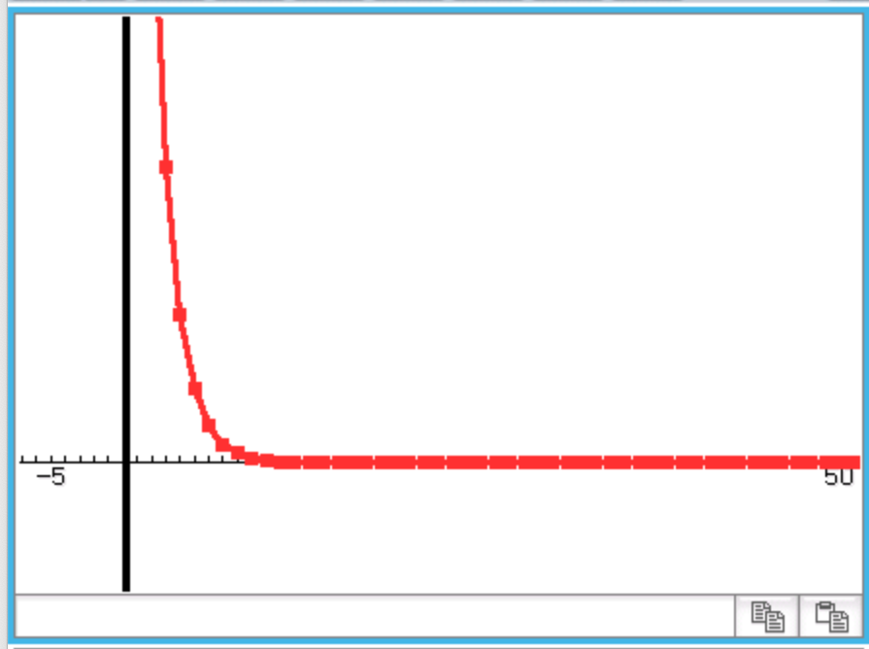
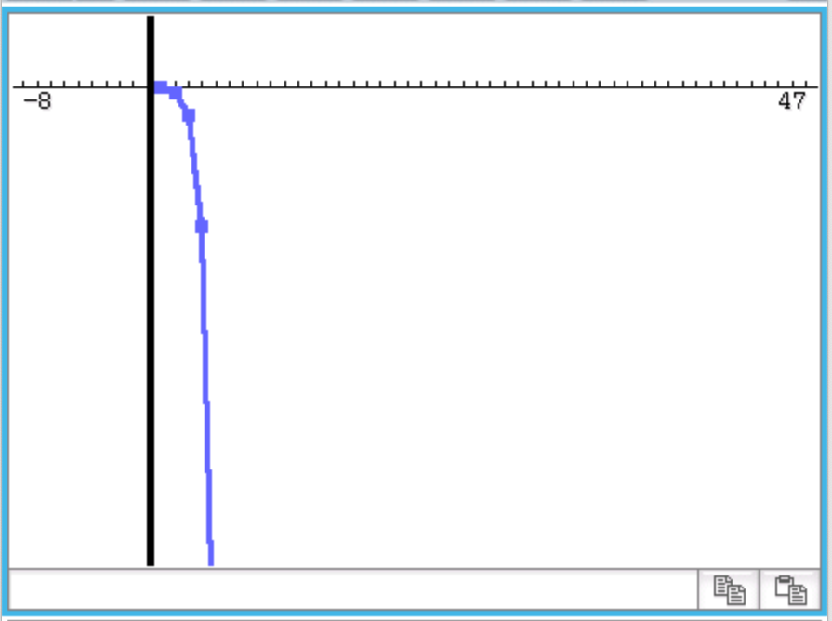
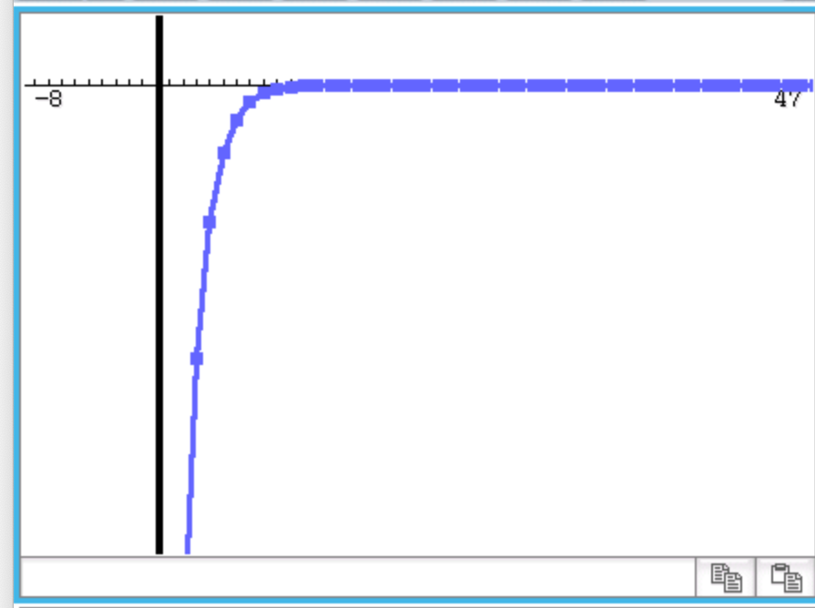
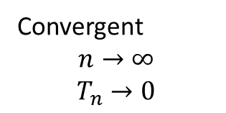
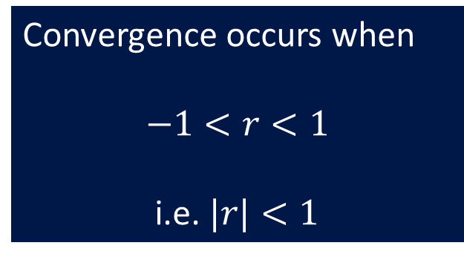
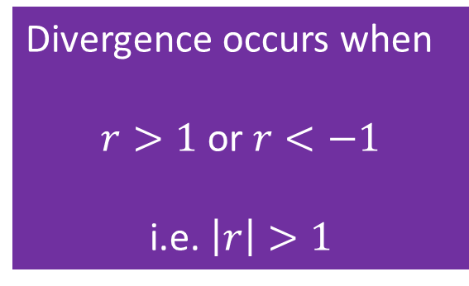

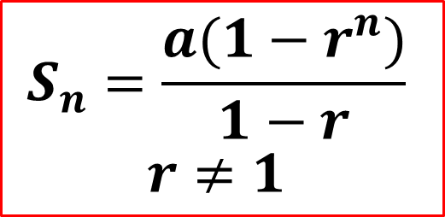


The possible graphs of geometric sequence
Convergent
$$n→∞$$
$$T_{n}→0$$
Divergent
$$n→∞$$
$$T_{n}→∞$$
$$S_{n}=\frac{a(1−r^{n})}{1−r}$$
$$r≠1$$
Divergent
$$n→∞$$
$$T_{n}→−∞$$
Convergent
$$n→∞$$
$$T_{n}→0$$
Divergence occurs when
$r>1$ or $r<−1$
i.e. $\left|r\right|>1$
Convergence occurs when
$$−1<r<1$$
i.e. $|r|<1$

Slide 4


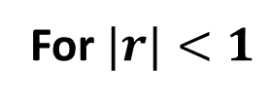


Considering the convergent geometric series
Concept Development
Since we know that $|r|<1$, therefore as $n→∞$, $r^{n}→0$. It is therefore possible to determine the the sum to infinity, $S_{∞}$.
$$S_{n}=\frac{a(1−r^{n})}{1−r}$$
$$S_{∞}=\frac{a(1−0)}{1−r}$$
$$S_{∞}=\frac{a}{1−r}$$
For $|r|<1$

Slide 5

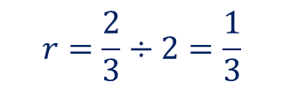

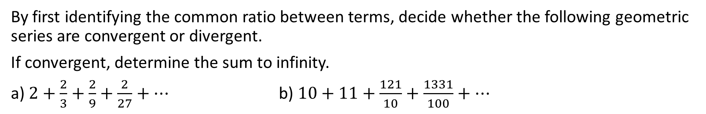

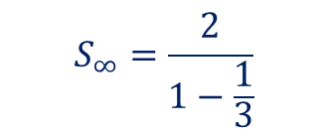


Guided Practice
$$S_{∞}=\frac{a}{1−r}$$
By first identifying the common ratio between terms, decide whether the following geometric series are convergent or divergent.
If convergent, determine the sum to infinity.
a) $2+\frac{2}{3}+\frac{2}{9}+\frac{2}{27}+…$ b) $10+11+\frac{121}{10}+\frac{1331}{100}+…$
$$r=\frac{2}{3}÷2=\frac{1}{3}$$
$$r=11÷10=1.1$$
$$\left|r\right|>1∴divergent$$
$$\left|r\right|<1∴convergent$$
$$S_{∞}=\frac{2}{1−\frac{1}{3}}$$
$$S_{∞}=3$$

Slide 6


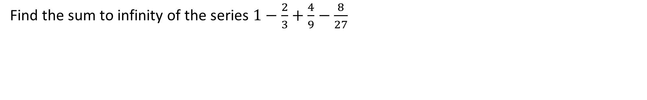
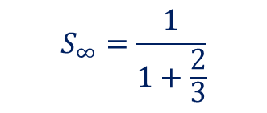

Guided Practice
$$S_{∞}=\frac{a}{1−r}$$
Find the sum to infinity of the series $1−\frac{2}{3}+\frac{4}{9}−\frac{8}{27}$
$$r=−\frac{2}{3}÷1=−\frac{2}{3}$$
$$\left|r\right|<1∴convergent$$
$$S_{∞}=\frac{1}{1+\frac{2}{3}}$$
$$S_{∞}=\frac{3}{5}$$

Slide 7
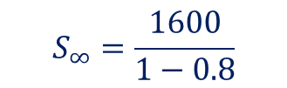



Guided Practice
$$S_{∞}=\frac{a}{1−r}$$
A square has a side length of 40 cm. A copy of the square is made so that the areao of the copy is 80% of the original one. The process is repeated so that each time the area of the new square is 80% of the previous one. If this process is repeated indefinitly, find the total area of all the squares.
Area of first square: ${40}^{2}=1600 cm^{2}$
$r=0.8<1∴convergent$
$$S_{∞}=\frac{1600}{1−0.8}$$
$$=8000 {cm}^{2}$$

Slide 8







Guided Practice
$$S_{∞}=\frac{a}{1−r}$$
Express the recurring decimal $0.\dot{3}\dot{2}$ as the ratio of two integers.
$$0.\dot{3}\dot{2}=0.32+0.0032+0.000032+ …$$
$$a=0.32, r=0.01$$
$$S_{∞}=\frac{0.32}{1−0.01}$$
$$=\frac{0.32}{0.99}=\frac{32}{99}$$
Express the recurring decimal $0.0\dot{3}\dot{5}$ as the ratio of two integers.
$$0.0\dot{3}\dot{5}=0.035+0.00035+0.0000035+ …$$
$$a=0.035, r=0.01$$
$$S_{∞}=\frac{0.035}{1−0.01}$$
$$=\frac{0.035}{0.99}=\frac{35}{990}$$
$$=\frac{7}{198}$$

Slide 9
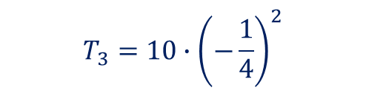
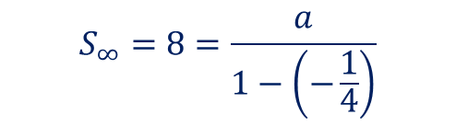
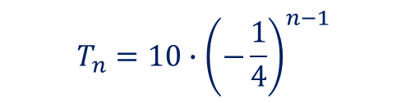
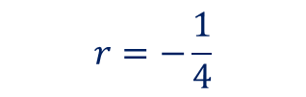






Guided Practice
$$S_{∞}=\frac{a}{1−r}$$
$$r=−\frac{1}{4}$$
$$T_{3}=10∙{\left(−\frac{1}{4}\right)}^{2}$$
$$S_{∞}=8=\frac{a}{1−\left(−\frac{1}{4}\right)}$$
$$T_{3}=10∙\left(\frac{1}{16}\right)$$
$$8=\frac{\frac{a}{5}}{4}$$
$$T_{3}=\frac{5}{8}$$
$$a=8×\frac{5}{4}$$
$$a=10$$
$$T_{n}=10∙{\left(−\frac{1}{4}\right)}^{n−1}$$

Slide 10
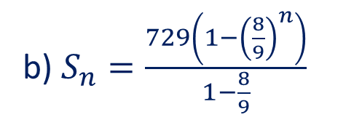


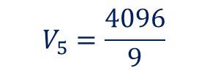

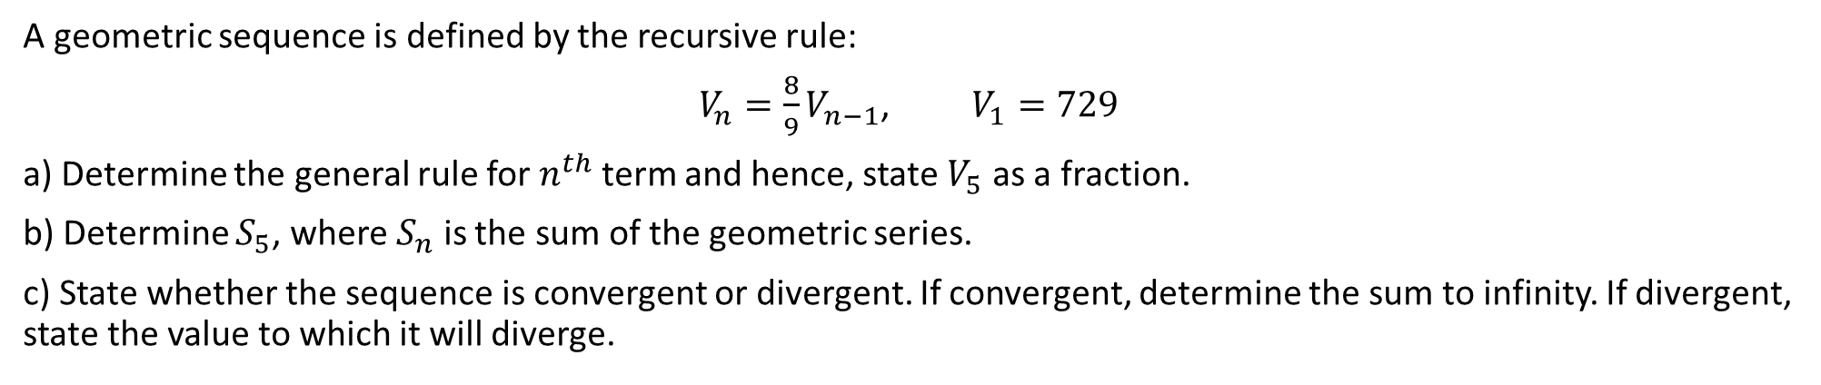
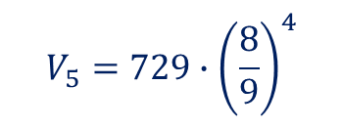

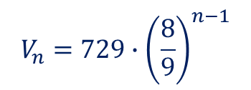

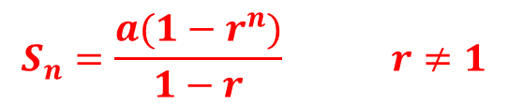

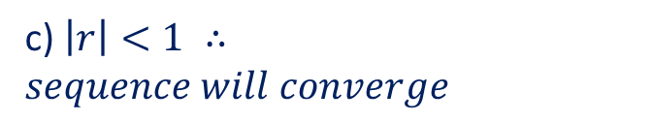
Guided Practice
$$S_{n}=\frac{a(1−r^{n})}{1−r} r≠1$$
$$S_{∞}=\frac{a}{1−r}$$
A geometric sequence is defined by the recursive rule:
$V_{n}=\frac{8}{9}V_{n−1}$, $V_{1}=729$
a) Determine the general rule for $n^{th}$ term and hence, state $V_{5}$ as a fraction.
b) Determine $S_{5}$, where $S_{n}$ is the sum of the geometric series.
c) State whether the sequence is convergent or divergent. If convergent, determine the sum to infinity. If divergent, state the value to which it will diverge.
a) $a=729, r=\frac{8}{9}$
b) $S_{n}=\frac{729\left(1−{\left(\frac{8}{9}\right)}^{n}\right)}{1−\frac{8}{9}}$
c) $\left|r\right|<1 ∴sequence will converge$
$$V_{n}=a∙r^{n−1}$$
$$V_{n}=729∙{\left(\frac{8}{9}\right)}^{n−1}$$
$$S_{n}=6561\left(1−{\left(\frac{8}{9}\right)}^{n}\right)$$
$$S_{∞}=\frac{729}{1−\frac{8}{9}}=6561$$
$$V_{5}=729∙{\left(\frac{8}{9}\right)}^{4}$$
$$S_{5}=6561\left(1−{\left(\frac{8}{9}\right)}^{n}\right)$$
$$V_{5}=\frac{4096}{9}$$
$$S_{5}=\frac{26281}{9}$$

Slide 11

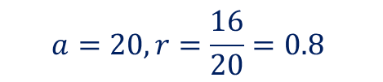


Guided Practice
$$S_{n}=\frac{a(1−r^{n})}{1−r} r≠1$$
$$S_{∞}=\frac{a}{1−r}$$
A ball is dropped from a height of 20 metres and it rebounds to a height of 16 metres. Every bounce, it continues to rebound to the same proportion of its previous height.
Calculate the total vertical distance travelled by the ball until bouncing stops.
$$a=20, r=\frac{16}{20}=0.8$$
$$\left|r\right|<1 ∴sequence is convergence$$
$S_{∞}=\frac{20}{1−0.8 }=100$m
$$Total vertical distance=2×100−20$$
$=180$ m

Slide 12

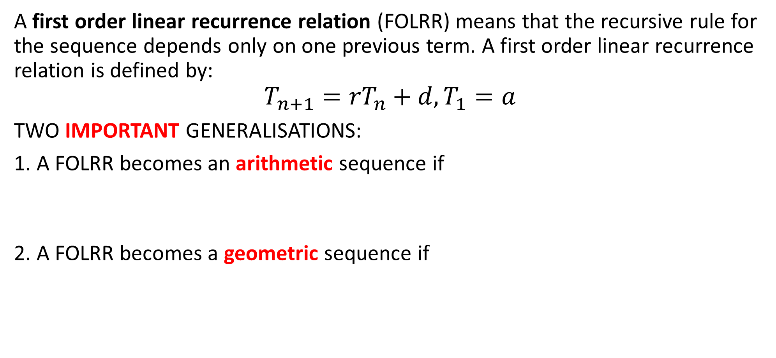

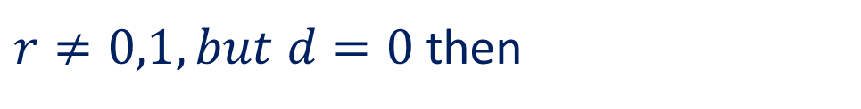
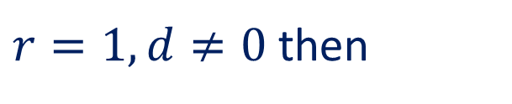
Summary of Sequences and Series
Summary
A first order linear recurrence relation (FOLRR) means that the recursive rule for the sequence depends only on one previous term. A first order linear recurrence relation is defined by:
$$T_{n+1}={rT}_{n}+d, T_{1}=a$$
TWO IMPORTANT GENERALISATIONS:
1. A FOLRR becomes an arithmetic sequence if
2. A FOLRR becomes a geometric sequence if
$r=1, d≠0$ then
$$T_{n+1}=T_{n}+d, T_{1}=a$$
$r≠0,1, but d=0$ then
$$T_{n+1}=r∙T_{n}, T_{1}=a$$

Slide 13




Nature of the Long-Term Behaviour in Recurrence Relations
It can become obvious in a list, table or graph the type of recurrence relation we are dealing with and the nature of the long-term state in a sequence. There are three main types of long-term states.
Long Term Behaviour | Behaviour statement
Long Term Increasing State – a long term increasing state refers to a sequence that has upward trend and continues in this way forever.
Long Term Decreasing State – a long term decreasing state refers to a sequence that has downward trend and continues in this way forever.
Long Term Steady State – If a recurrence relation has a long-term steady then over a long period of time, the sequence will tend to a particular value.

Slide 14
Independent Practice
Complete Ex 15F

